Slide 1

Chapter 5 MANAGEMENT INFORMATION SYSTEM
Bikash Adhikari
bikashadh044@gmail.com
Acknowledgement: Khem Gyawali
Mechanical Engineer

Slide 2


Management Information System – course outline
Data and Information
Need, function and Importance of MIS
Evolution of MIS
Organizational Structure and MIS
Computers and MIS
Classification of Information Systems
Information Support for functional areas of management
Organizing Information Systems

Slide 3
Management Information System
Management: The direction of enterprises toward the achievement of a predetermined objectives. It is carried out by managers.
Information: An aggregate of facts so organized as to provide knowledge. It is an output obtained by processing data as input.
System: An assembly of procedure, processes, methods or techniques united by some form of regulated interaction to form an organized whole.
Management Information System (MIS) can be defined as “a system of obtaining, abstracting, storing and analyzing data (new facts) to produce information for use in planning, controlling, and decision making by yielding information for managers, at the time they can most effectively use it”.

Slide 4
1. Data and Information
Data:
Un interpreted raw statement of facts.
Group of non-random symbols (works, valves, figures) which represent things that have happened .
Obtained by research or observation.
Eg. Payroll, bank statement etc.
Information:
Aggregate of facts so organized as to provide the desired knowledge.
Data that have been interpreted and understand by the recipient of the message.
Can have different meaning to different people.

Slide 5
1. Data and Information
Difference between Data & Information
Data (Input)
Processing
Information (Output)
Feedback/Control

Slide 6
1. Data and Information
Qualities of Good Information
Accuracy
Timeliness
Completeness
Conciseness
Relevancy
Frequency
Understandable

Slide 7
2. Need, Function and Importance of MIS
Needs:
Production managers: production costs, labor costs, machine costs, overhead costs.
Marketing managers: new product development, new product sales trend, selling costs, market research.
Personnel managers: work forces turnover, absenteeism, employ skill level, labor markets, wage level.

Slide 8
2. Need, Function and Importance of MIS
Functions:
Determination of information needs. (How much? How, when and by whom? What?)
Evaluation. ( How much confidence?)
Abstraction. ( Editing and reducing incoming information)
Dissemination. ( Getting the right information to the right manager at the right time)

Slide 9
2. Need, Function and Importance of MIS

Slide 10
2. Need, Function and Importance of MIS
Importance:
Provides relevant information available in the right form at the right time.
Bring the new facts to the knowledge of the management.
Supply the desired information at a reasonable cost.
Keep the information up to date.
Store the important and confidential information properly for utilizing it for decision-making whenever required.
Focus on those decisions where benefit/cost ratio is attractive.
Supply reliable and logical data.
Provide data for carrying out the major management functions.

Slide 11
3. Evolution of MIS
Digital computers 1959,
Electronic data processing (EDP)
Focus on record keeping
Card punching machine
Computer languages
Personal computers
Direct end user involvement
Steady performance
User friendly and graphical user interface.
Design support system (DSS)
Operation research
Executive information system (EIS)

Slide 12
4. Organizational Structure and MIS
The nature of organizations determines their activities, the information support they need, and the type of information systems they use
profit-making business versus not-for-profit organizations exist
manufacture goods versus services are delivered
can be located in one place or in several places, some are global or multinational organizations
MIS has been described as a pyramidal structure, with four levels of information resources. The levels of information would depend upon the organizational structure.

Slide 13
4. Organizational Structure and MIS
The top level supports strategic planning and policy making at the highest level of management.
The second level of information resources aid tactical planning and decision making for management control.
The third level supports day-to-day operations and control.
The bottom level consists of information for transaction processing.
It then follows that since decision making is specific to hierarchical levels in an organization, the information requirements at each level vary accordingly.
Thus, MIS as a support system draws upon:
concepts of organization;
organizational theories, principles, structure, behavior and processes such as communication, power and decision making; and
motivation and leadership behavior.

Slide 14
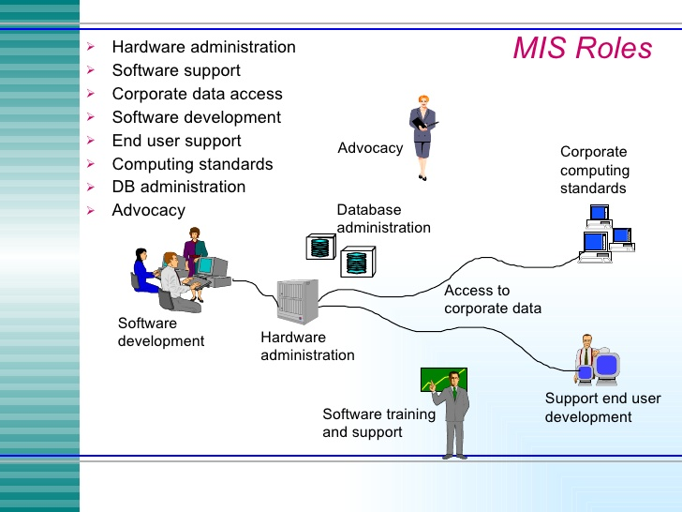
4. Organizational Structure and MIS

Slide 15
5. Computers and MIS
Computers are means of management information system. With the use of computers MIS will be efficient and effective. But, the mere fact of using a computer does not itself mean that work is done more efficiently. It is also not necessary that better information is produced. Very often computers are introduced in an attempt to solve technical problem when the real problem is one concerned with management or other things. It is therefore essential that problems are clearly identified before a computer system is used.
For clarity, the use of computers will be outlined in two broad categories:
The routine processing of day-to-day transactions, known as data processing or transaction processing.
The use of computers by the end-users themselves. The end users include mangers, accountants, office staff, sales people, executive and others.

Slide 16
5. Computers and MIS
Both data processing and end-user computing produce management information. The key difference is that data processing systems supply pre determined outputs and reports so there is less flexibility. This means that great care must be taken in analyzing and determining managements real information needs before the system is designed.
On the other hand with end-user computing there is more flexibility and interaction so that the emphasis becomes one of supporting the end user rather than the production of a specified report.

Slide 17
6. Classification of Information Systems
An information system is a collection of hardware, software, data, people and procedures that are designed to generate information that supports the day-to-day, short-range, and long-range activities of users in an organization. Information systems generally are classified into four categories:
Transaction Processing Systems (TPS)
Management Information Systems (MIS)
Decision-Support Systems (DSS)
Executive Support Systems (ESS)

Slide 18
6. Classification of Information Systems
Transaction Processing Systems
A transaction processing system (TPS) is an information system that captures and processes data generated during an organization’s day-to-day transactions. A transaction is a business activity such as a deposit, payment, order or reservation.
Basic business systems that serve the operational level.
A computerized system that performs and records the daily routine transactions necessary to the conduct of the business.
Today, most transaction processing systems use online transaction processing. Some routine processing tasks such as calculating paychecks or printing invoices, however, are performed more effectively on a batch basis. For these activities, many organizations still use batch processing techniques.

Slide 19
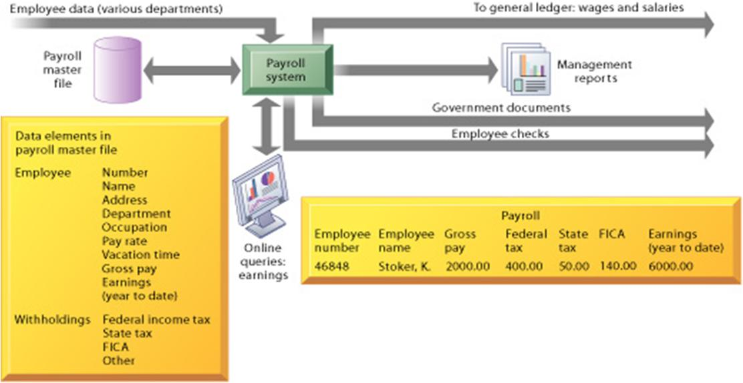
6. Classification of Information Systems
A Symbolic Representation for a Payroll TPS

Slide 20
6. Classification of Information Systems
Management Information Systems (MIS)
Management level
Inputs: High volume transaction level data
Processing: Simple models
Outputs: Summary reports
Users: Middle managers
Example: Annual budgeting
A management information system, or MIS (pronounced em-eye-ess), is an information system that generates accurate, timely and organized information so managers and other users can make decisions, solve problems, supervise activities, and track progress. Because it generates reports on a regular basis, a management information system sometimes is called a management reporting system (MRS).
An MIS generates three basic types of information: detailed, summary and exception. Detailed information typically confirms transaction processing activities. A Detailed Order Report is an example of a detail report. Summary information consolidates data into a format that an individual can review quickly and easily. To help synopsize information, a summary report typically contains totals, tables, or graphs. An Inventory Summary Report is an example of a summary report

Slide 21
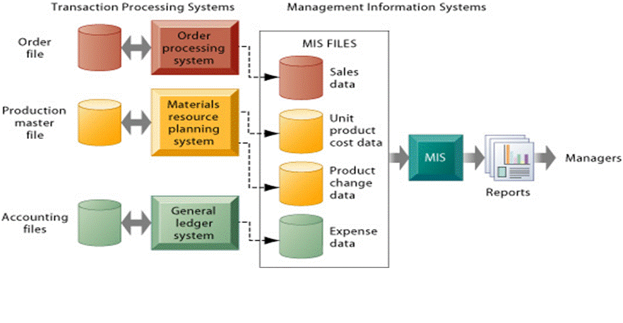
6. Classification of Information Systems

Slide 22
6. Classification of Information Systems
Decision-Support Systems (DSS)
Management level
Inputs: Transaction level data
Processing: Interactive
Outputs: Decision analysis
Users: Professionals, staff
Example: Contract cost analysis
A decision support system (DSS) is an information system designed to help users reach a decision when a decision-making situation arises. A variety of DSSs exist to help with a range of decisions. A decision support system uses data from internal and/or external sources.
Internal sources of data might include sales, manufacturing, inventory, or financial data from an organization’s database. Data from external sources could include interest rates, population trends, and costs of new housing construction or raw material pricing. Users of a DSS, often managers, can manipulate the data used in the DSS to help with decisions.

Slide 23
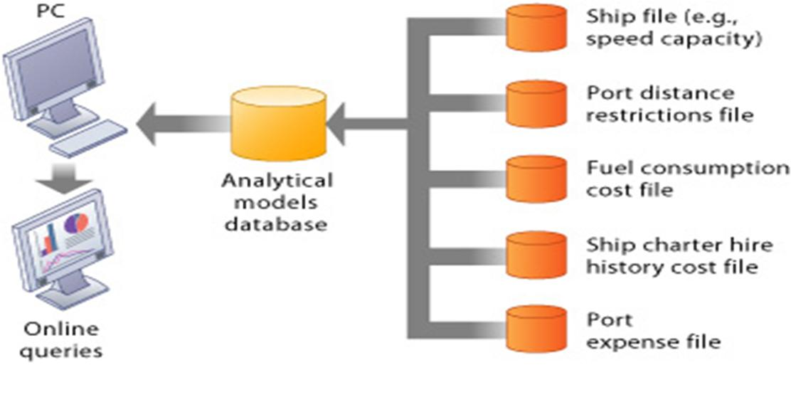
6. Classification of Information Systems
Voyage-estimating decision-support system

Slide 24
6. Classification of Information Systems
EXECUTIVE SUPPORT SYSTEMS (ESS)
Management level
Inputs: Aggregate data
Processing: Interactive
Outputs: Projections
Users: Senior managers
Example: 5 year operating plan
An expert system is an information system that captures and stores the knowledge of human experts and then imitates human reasoning and decision-making processes for those who have less expertise. Expert systems are composed of two main components: a knowledge base and inference rules. A knowledge base is the combined subject knowledge and experiences of the human experts. The inference rules are a set of logical judgments applied to the knowledge base each time a user describes a situation to the expert system.

Slide 25
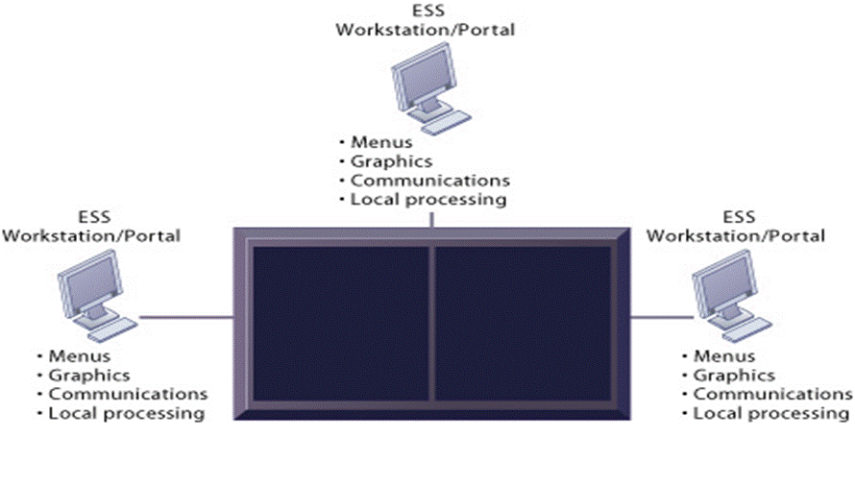
6. Classification of Information Systems
Model of a Typical Executive Support System

Slide 26
6. Classification of Information Systems
Integrated Information Systems
With today’s sophisticated hardware, software and communications technologies, it often is difficult to classify a system as belonging uniquely to one of the five information system types discussed. Much of today’s application software supports transaction processing and generates management information.
Other applications provide transaction processing, management information, and decision support. Although expert systems still operate primarily as separate systems, organizations increasingly are consolidating their information needs into a single, integrated information system.

Slide 27
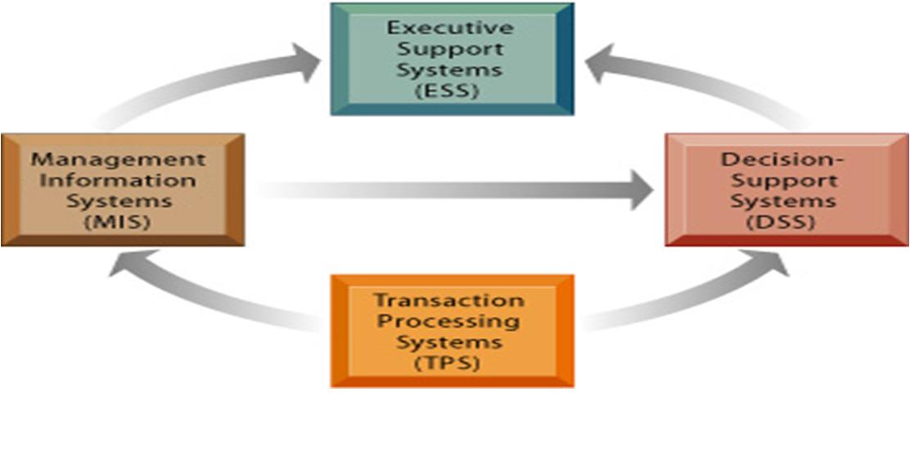
6. Classification of Information Systems
Interrelationships among systems

Slide 28
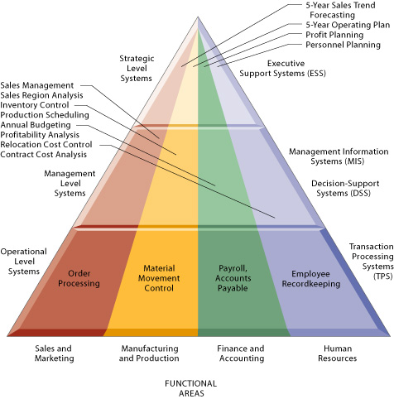
7. Information Support for functional areas of management

Slide 29
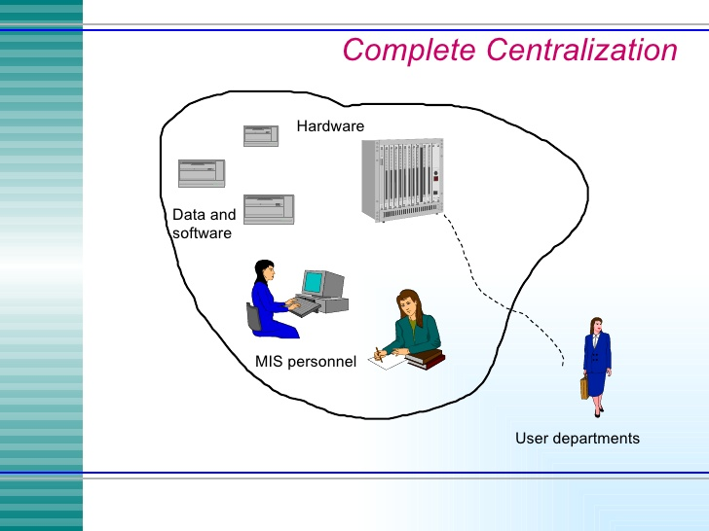
8. Organizing Information Systems

Slide 30
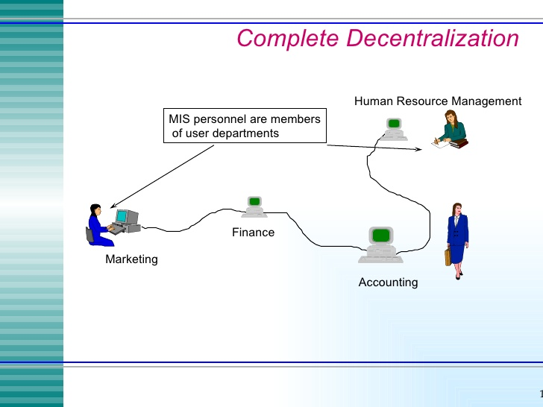
8. Organizing Information Systems

Slide 31

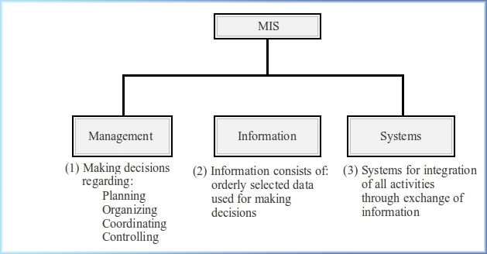
THANK YOU!!!

